Slide 1
Linear Regression and Gradient Descent
Rose Sloan
rsloan@bard.edu

Slide 2
Linear Models, More Broadly
Perceptron is one linear model, but there are others
Basic concept: find the coefficients of a linear equation (hyperplane) that we can use to make predictions
Classification: assume data can be split by a hyperplane
Regression: assume data is all close to being on a hyperplane

Slide 3
Linear Regression
Given a regression problem, we can predict that the output y at some point x is a linear function on x
This linear function is called the hypothesis:
Given a point x = <x₁, x₂, …, x_{n}> and defining x₀ = 1 for all x:
h_{w}(x) = w₀ + w₁x₁ + w₂x₂ + … + w_{n}x_{n}
Goal: find optimal values for w

Slide 4
Least Squares
Must first define a cost function J, so that we know what to minimize
Cost function: like a loss function but defined over a data set instead of at a point (but in practice, the terms are often used interchangeably)
Here: cost function is based on sum of squared differences
Because this is our loss function, this is least squares regression

Slide 5
Gradient Descent
Cost is a function of weights
Goal: find weights to minimize costs
Approach: start with random weights, repeatedly adjust them in the “best” direction until we hit a minimum
What’s the “best” direction? The gradient (derivative) with respect to w
Note: this works for any parametric model with a differentiable cost function!

Slide 6
Gradient Descent Visualized

Slide 7
Gradient Descent in Practice
Initialize all weights randomly (or to 0)
Compute the derivatives of cost wrt weights
Multiply derivatives by small constant learning rate
This ensures we’re always taking very small steps!
Subtract learning rate*gradient from previous weights
Repeat until we hit a minimum!

Slide 8
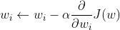
Doing the Math
Recall:
We want to update weight w_{i} by subtracting the partial derivative of J with respect to w_{i}, multiplied by the learning rate:

Slide 9
Computing the Derivative
Recall the chain rule:
From the chain rule:
Therefore:

Slide 10
Choosing a Learning Rate
The one hyperparameter for this algorithm is the learning rate α
α should be a very small number
Too large learning rate: might “go past” our minimum and never converge
If cost function is going up during training, try a lower learning rate
Too small learning rate: may take too long to converge
In practice: for features scaled between 0 and 1, 0.01 usually is a good choice for α

Slide 11
Batch Gradient Descent: Pseudocode
batch_grad_desc(D, α):
set w_{i} to 0 for for i from 0 to n
while derivatives are nonzero:
for i in (0, 1, 2, …, n):
deriv = sum over all (x,y) in D of (h_{w}(x) - y)x_{i}
w_{i} = w_{i} - α*deriv
return w₀, w₁, w₂, …, w_{n}

Slide 12
An Example: Housing Prices
Area (1000 square ft) | Bedrooms | Price ($1000s)
2.104 | 3 | 400
1.600 | 3 | 330
2.400 | 3 | 369
1.416 | 2 | 232
3.000 | 4 | 540
w₀ + w₁*area + w₂*bedrooms = price

Slide 13
Housing Prices: Area vs. Price

Slide 14
First Iteration
Initially, set w = <0, 0, 0>, learning rate to 0.001
Now calculate all the partial derivatives
Square footage | Bedrooms | Price | h(x) | h(x) - y | (h(x) - y)x_0 | (h(x) - y)x_1 | (h(x) - y)x_2
2.104 | 3 | 400 | 0 | -400 | -400 | -841.6 | -1200
1.6 | 3 | 330 | 0 | -330 | -330 | -528 | -990
2.4 | 3 | 369 | 0 | -369 | -369 | -885.6 | -1107
1.416 | 2 | 232 | 0 | -232 | -232 | -328.512 | -464
3 | 4 | 540 | 0 | -540 | -540 | -1620 | -2160
SUMS |  |  |  |  | -1871 | -4203.712 | -5921

Slide 15
First Iteration
We have now found that at w = <0, 0, 0>, the derivative of J(w) is < -1781, -4203.7, -5961>
We now multiply this by the learning rate of 0.001 before updating the weights
New weights:
<0, 0, 0> - 0.001*< -1781, -4203712, -5961> = <1.781, 4.203, 5.961>

Slide 16
Second Iteration
Now we repeat this, computing h(x) with our new weights
Update weights based on learning rate:
<1.781, 4.203, 5.961> - 0.001*<-1728, -3887, -5475> = <3.6, 8.1, 11.4>
Square footage | Bedrooms | Price | h(x) | h(x) - y | (h(x) - y)x_0 | (h(x) - y)x_1 | (h(x) - y)x_2
2.104 | 3 | 400 | 28.48 | -371.52 | -371.52 | -781.68 | -1114.56
1.6 | 3 | 330 | 26.36 | -303.64 | -303.64 | -485.82 | -910.92
2.4 | 3 | 369 | 29.72 | -339.28 | -339.28 | -814.27 | -1017.83
1.416 | 2 | 232 | 19.67 | -212.33 | -212.33 | -300.67 | -424.67
3 | 4 | 540 | 38.17 | -501.83 | -501.83 | -1505.5 | -2007.34
 |  |  |  |  | -1728.61 | -3887.94 | -5475.32

Slide 17
Continuing
Because we are only updating the weights a small amount each time, we need to repeat this many times
In the 20th iteration, the derivative is down to <-407, -957, -1338> and the weights are <19.5, 44.3, 62.2>, but overall cost still very large
In the 50th iteration, the derivative is <-20, -99, -128> and the weights are <23.6, 55.1, 77.1> and overall cost is 3802
After 100 iterations, derivatives are close to 0, weights are <23.1, 56.6, 78.7>, with a overall cost of 3404

Slide 18
After 100 Iterations
Square footage | Bedrooms | Price ($1000s) | h(x)
2.104 | 3 | 400 | 378.1
1.6 | 3 | 330 | 349.6
2.4 | 3 | 369 | 394.8
1.416 | 2 | 232 | 260.5
3 | 4 | 540 | 507.4
23.1 + 56.6*area + 78.7*bedrooms = price

Slide 19
Batch Gradient Descent
So far, we have always calculated the derivative of the cost function on the entire data set
Because we are using all the data at once, we call this batch gradient descent
This lets us always reach a minimum (assuming appropriate learning rates)
However, on big data, the derivative calculation is very costly and must be repeated many times

Slide 20
Stochastic Gradient Descent
In stochastic gradient descent, look at one point at a time
Calculate derivative of the cost function at that point, then adjust weights immediately
Because individual steps may take us in the wrong direction overall, we may need to use a smaller learning rate
Will likely never converge, need to use other stopping criteria
Using validation loss is common

Slide 21
Stochastic Gradient Descent Pseudocode
stoch_grad_desc(D, α):
set w_{i} to 0 for for i from 0 to n
while stopping criteria are not met:
for (x, y) in D
for i in (0, 1, 2, …, n):
deriv = (h_{w}(x) - y)x_{i}
w_{i} = w_{i} - α*deriv
return w₀, w₁, w₂, …, w_{n}

Slide 22
Housing Prices via Stochastic Gradient Descent
Last time, we calculated the derivatives by summing the partial derivatives over all points in our data set before taking a step
This took a lot of iterations to converge because we were only moving a small amount each step
For five data points, this works okay, but these sums will take a very long time with more data
Instead, try stochastic gradient descent

Slide 23
An Example: Housing Prices
Area (1000 square ft) | Bedrooms | Price ($1000s)
2.104 | 3 | 400
1.600 | 3 | 330
2.400 | 3 | 369
1.416 | 2 | 232
3.000 | 4 | 540
w₀ + w₁*area + w₂*bedrooms = price

Slide 24
First Iteration
Point 1: x = <2.104, 3>, y = 400, w = <0, 0, 0>
h_{w}(x) = 0
x₀h_{w}(x) – y = h_{w}(x) – y = -400
x₁h_{w}(x) – y = 2.104*(h_{w}(x) – y) = -841.6
x₂h_{w}(x) – y = 3*(h_{w}(x) – y) = -1200
Update weights to <0,0,0> - 0.01*<-400,-841.6,-1200> = <4, 8.416, 12>
Point 2: x = <1.6, 3>, y = 330, w = <4, 8.416, 12>
h_{w}(x) = 53.5
x₀h_{w}(x) – y = h_{w}(x) – y = -276.5
x₁h_{w}(x) – y = 1.6*(h_{w}(x) – y) = -442.5
x₂h_{w}(x) – y = 3*(h_{w}(x) – y) = -829.6
Update weights to <4, 8.416, 12> - 0.01*<-276.5,-442.5,-829.5> = <6.8, 12.8, 20.3>

Slide 25
First Iteration
Point 3: x = <2.4, 3>, y = 369, w = <6.8, 12.8, 20.3>
h_{w}(x) = 98.5, h_{w}(x) – y = -270.5
∇w = <-270.5, -649.3, -811.6>
Update weights to w - 0.01* ∇w = <9.5, 19.3, 28.4>
Point 4: x = <1.416, 2>, y = 232, w = <9.5, 19.3, 28.4>
h_{w}(x) = 93.7, h_{w}(x) – y = -138.3
∇w = <-138.3, -195.9, -276.7>
Update weights to w - 0.01* ∇w = <10.9, 21.3, 31.2>
Point 5: x = <3, 4>, y = 540, w = <10.9, 21.3, 31.2>
h_{w}(x) = 199.4, h_{w}(x) – y = -340.6
∇w = <-340.6, -1021.7, -1362.2>
Update weights to w - 0.01* ∇w = <14.3, 31.5, 44.8>

Slide 26
After One Iteration
At the end of one iteration of stochastic gradient descent, our weights are <14.3, 31.5, 44.8>
This is pretty similar to the weights after 10 iterations of batch gradient descent
We now need to repeat this process for further iterations

Slide 27
More Iterations
After the second iteration, w = <20.3, 45.3, 64.3>
These values are pretty similar to what we got after 20 iterations of batch gradient descent
Cost is still quite high, but most predictions are within 100 of the true value
After the third iteration, w = <22.9, 51.4, 72.8>
Cost is now 7824
After 6 iterations, w = <24.1, 56.3, 79.1> and cost is 3457
This is slightly worse cost than the model from batch gradient descent
After 7 iterations, cost increases slightly, so we stop training

Slide 28
Batch vs. Stochastic Gradient Descent
It takes roughly the same amount of time to do an iteration of batch vs. stochastic gradient descent
Either way, one iteration does all the calculations for each data point once
Because we update weights mid-iteration in stochastic, it will finish training much faster
However, batch gradient descent will generally get closer to the actual minimum, because it’s always going in the “right” direction
In practice: use batch gradient descent if the data is small (<1000 points), otherwise use stochastic gradient descent
With “real” ML problems, this mostly means we’ll be using stochastic

Slide 29
Finding Minima
Gradient descent can be used with any differentiable cost function
However, they will only ever find local minima, because we stop as soon as the derivative is 0
Therefore: we can effectively use gradient descent if (and only if) the cost function has exactly one local minimum
This is the same as saying the function is convex
For least squares, our cost function is quadratic and therefore works well with gradient descent

Slide 30
Least Squares Cost Function

Slide 31
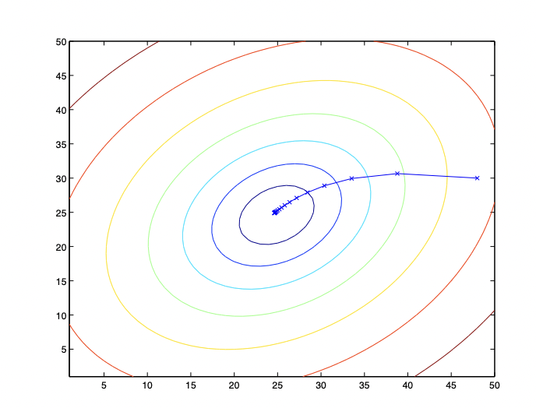
Least Squares Gradient Descent

Slide 32
A Closed Form
We will use gradient decent many times in the class, as there are many cost functions where directly finding a minimum is difficult
For linear regression, however, we can find a minimum directly
Recall:
We need to solve ∇_{w}J(w) = 0

Slide 33
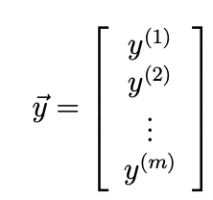
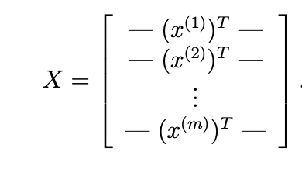
Doing the Math
Let us define:

Slide 34
Doing the Math
h_{w}(x^{(i)}) = w₀x^{(i)}₀ + w₁x^{(i)}₁+ w₂x^{(i)}₂ + …, so
Then:

Slide 35
Doing the Math
For any vector z,
Thus:

Slide 36
Doing the Math
Now:
Setting this to 0 gives us:
Notes:
Full details in lecture notes

Slide 37
Finally: A Closed Form
We have shown:
Note that if we have N data points and f features, X is a Nxf matrix
X^{T}X is a fxf matrix, which can generally be inverted quickly by computer even for large values of X

Slide 38
Homework: Old Faithful
The intervals between eruptions of Old Faithful can be predicted from the previous interval’s duration:
interval = w_0 + w_1*duration

Slide 39
Exercise
Run gradient descent on a dataset of Old Faithful eruption durations and intervals to find optimal values for w_0 and w_1
12 data points, should run very quickly
Most of a program for batch gradient descent has been written—update it to calculate the gradient properly
Implement stochastic gradient descent, compare number of iterations

